Slide 1
Reading and phonics meeting for Reception class parents.
9th October 2023
Teach reading: change lives
Parent workshop: Phonics and early reading

Slide 2


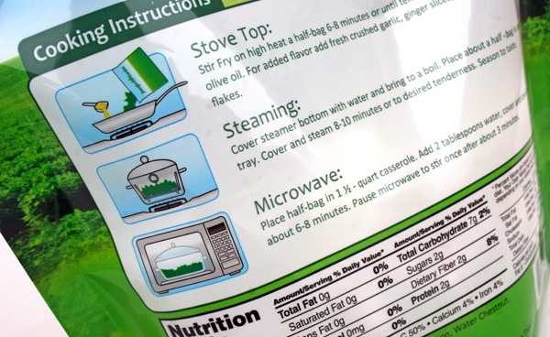
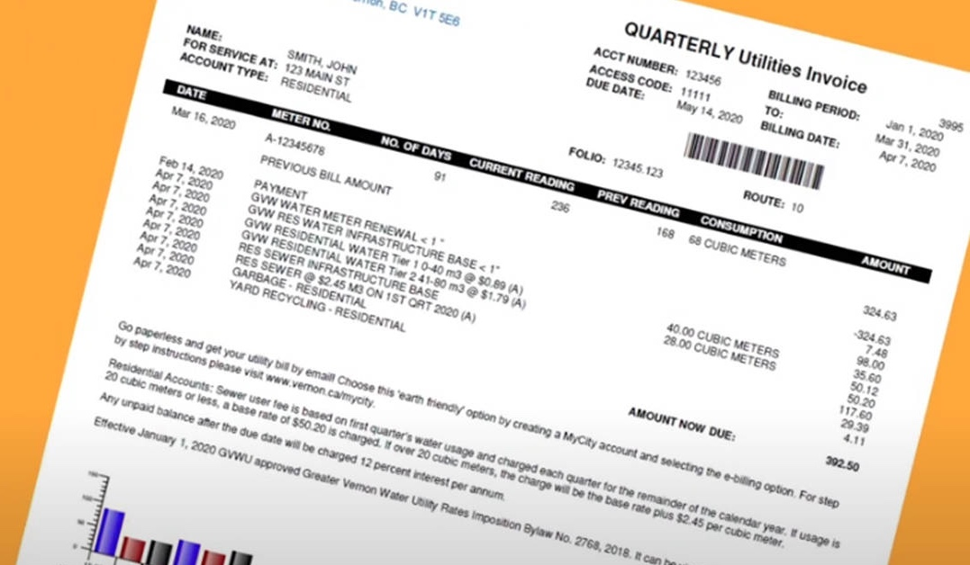
How many times have you already read today?
Notes:
Just think about how many times you have already read things today. It really is a vital skill.

Slide 3
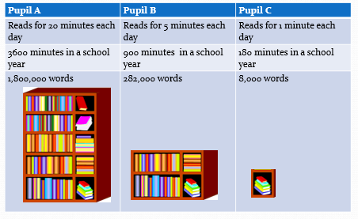
Best way to acquire new vocabulary is through reading:

Slide 4

Phonics

Slide 5
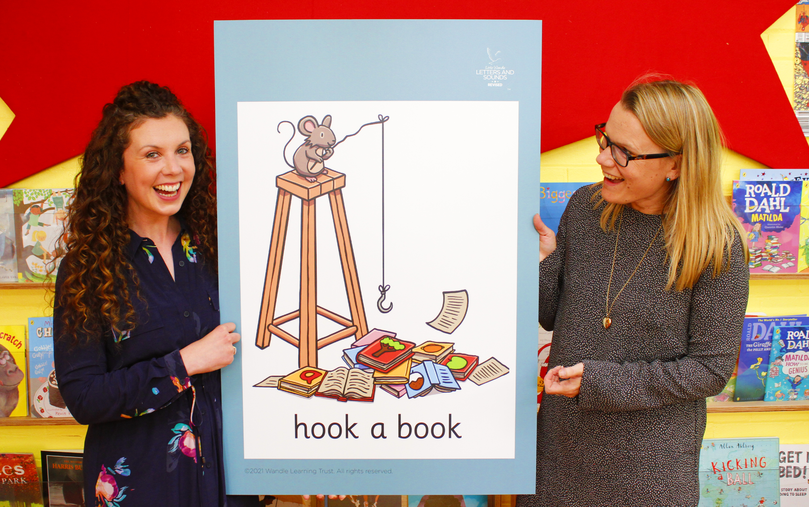
Little Wandle Letters and Sounds Revised
Our school has chosen
Little Wandle Letters and Sounds Revised as our systematic, synthetic phonics (SSP) programme to teach early reading and spelling.

Slide 6
Phonics is:
making connections between the sounds of our spoken words and the letters that are used to write them down.

Slide 7
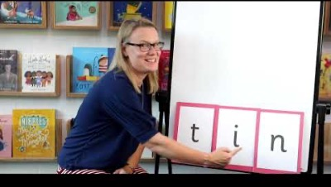
Blending to read words

Slide 8
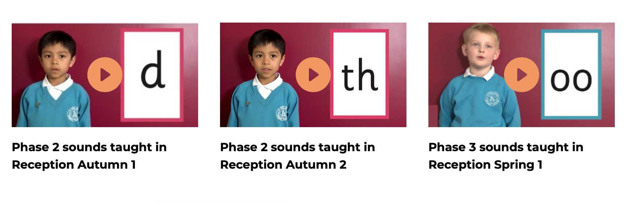
Supporting your child with phonics
Notes:
https://www.littlewandlelettersandsounds.org.uk/resources/for-parents/

Slide 9
Terminology
Phoneme
Split vowel digraph
Grapheme
Blend
Digraph
Segment
Trigraph

Slide 10
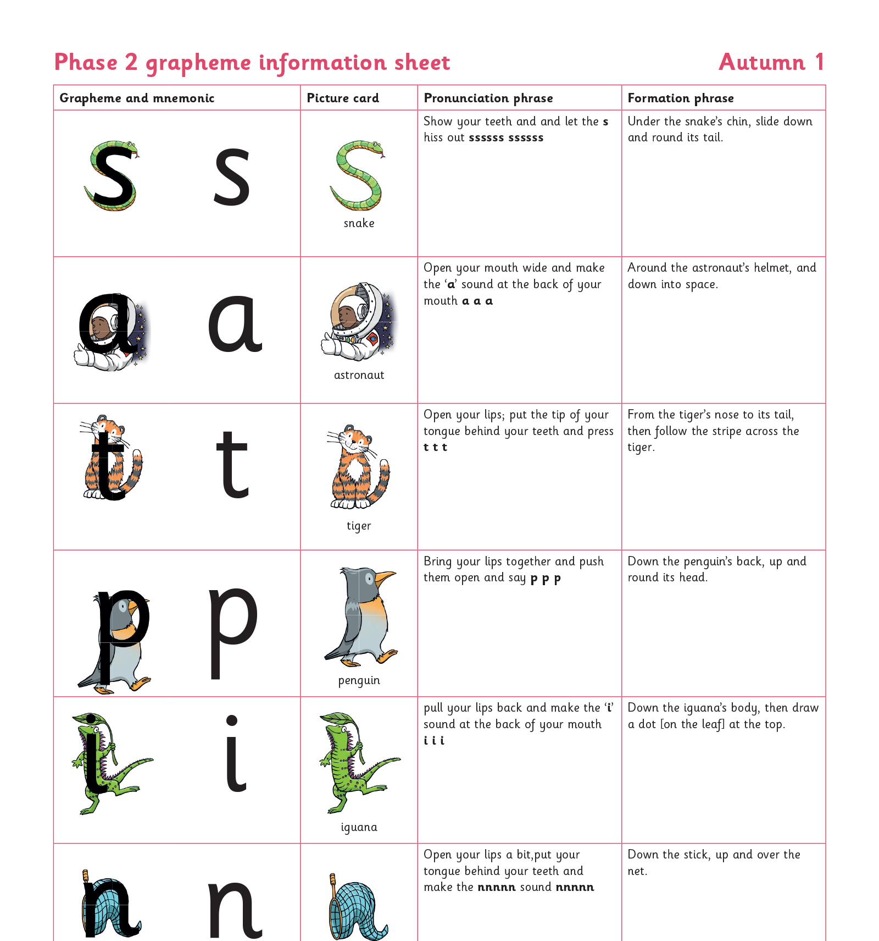
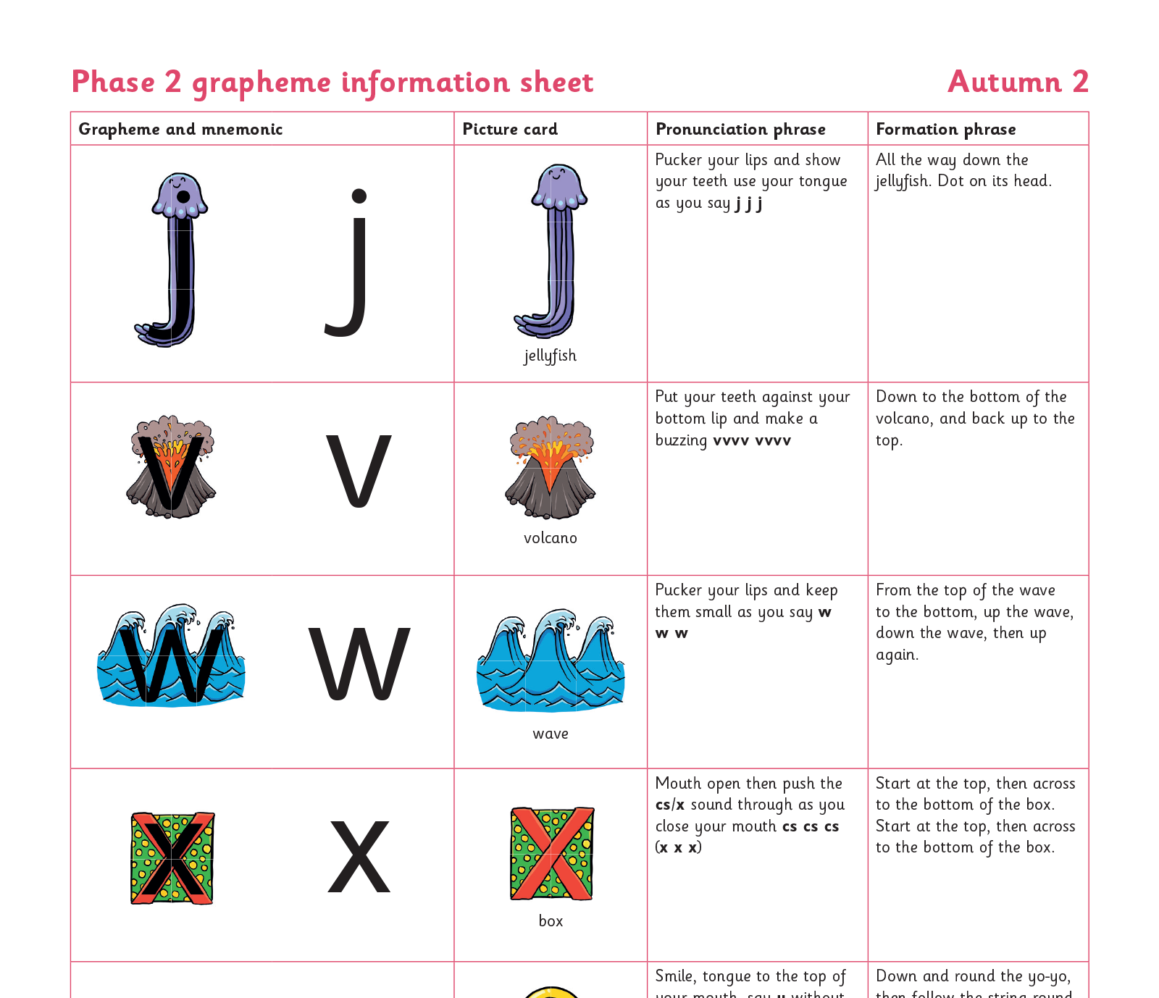
Teaching order

Slide 11
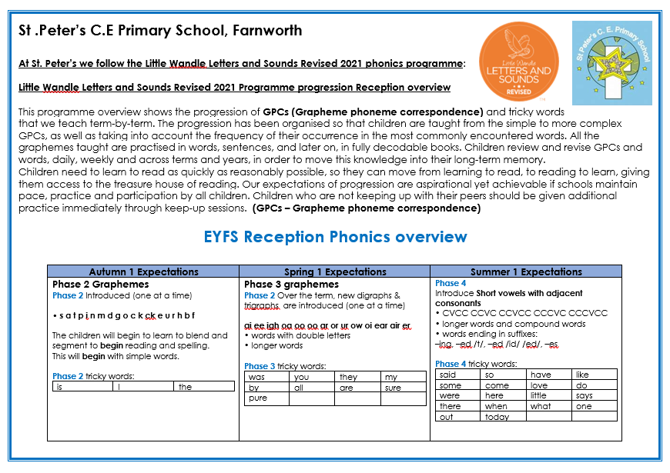
Teaching sequence

Slide 12
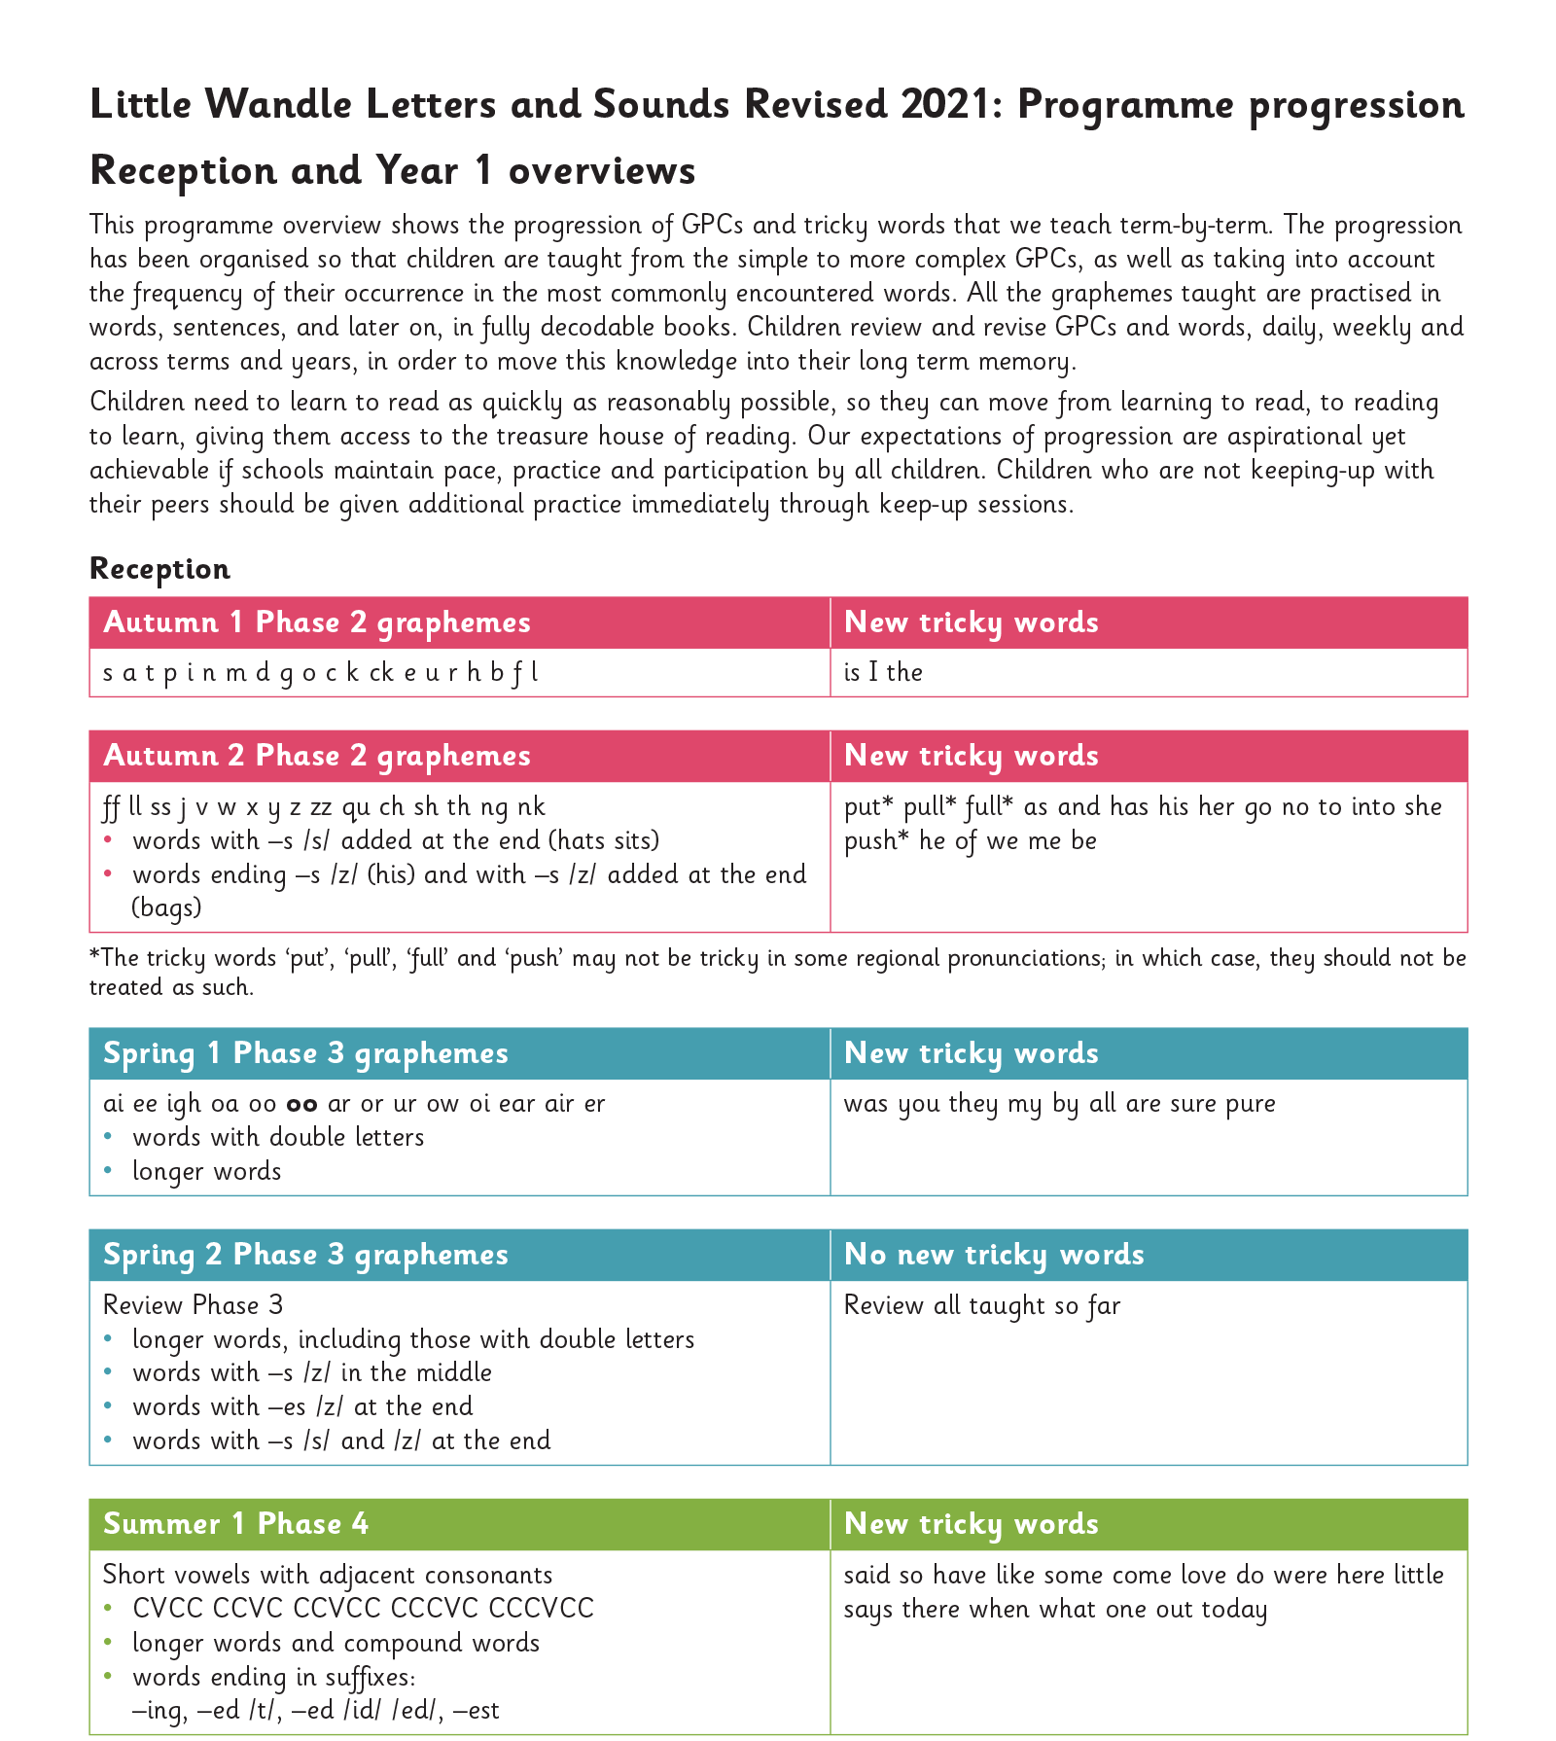
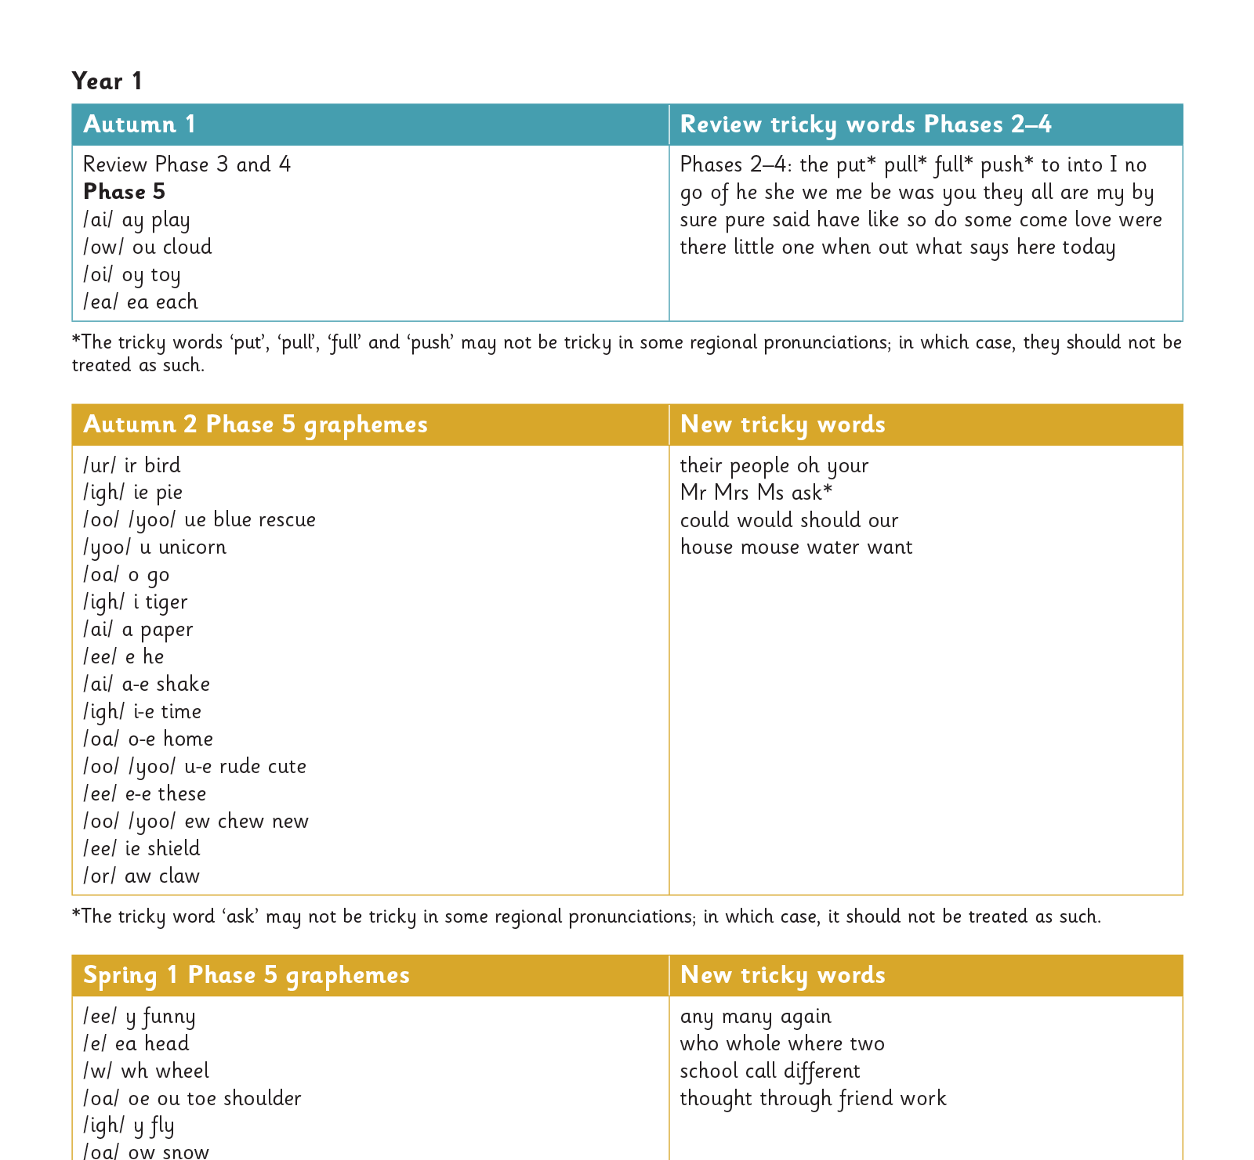
Gradually your child learns the entire alphabetic code:

Slide 13
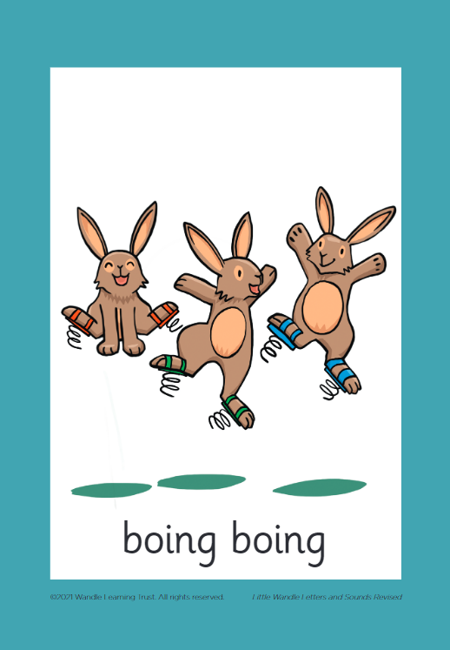



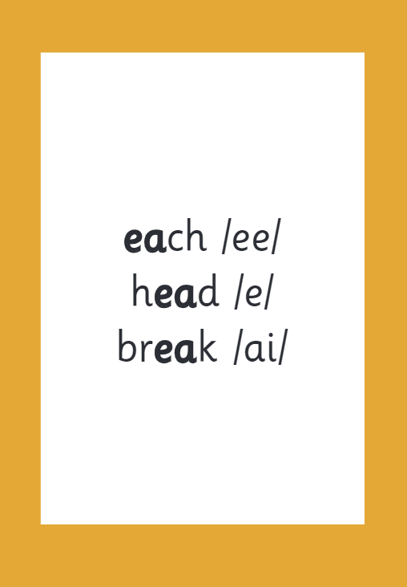

How we make learning stick

Slide 14
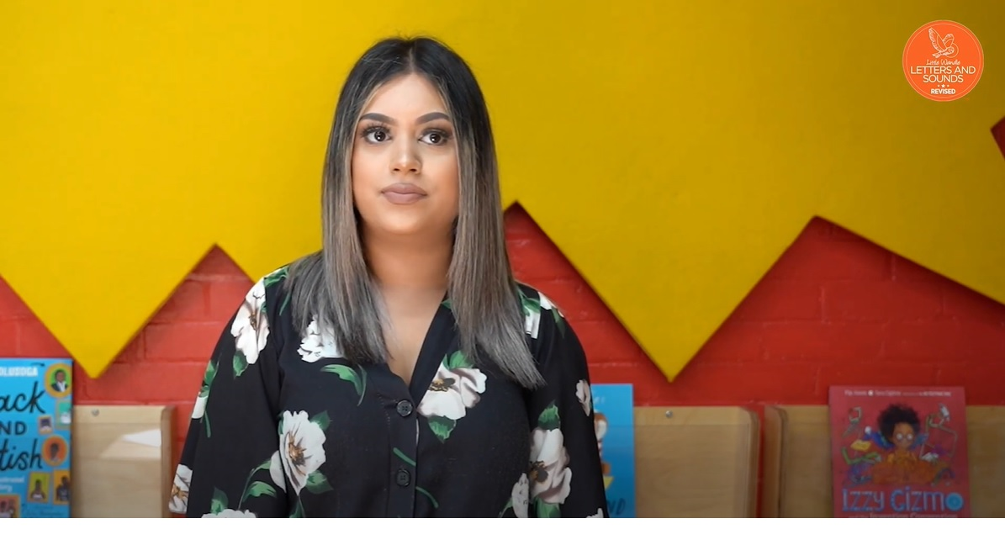
Tricky words

Slide 15
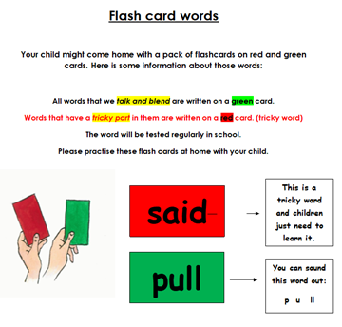
Flashcards:
Children take home a pack of flashcards on red and green cards.
Words that we ‘sound talk and blend’ are written on a green card.
Words that have a ‘tricky part’ in them are written on a red card, tricky words
Words will be tested regularly in school.
Parents encouraged to practise these flash cards at home.

Slide 16
Reading at home

Slide 17

The most important thing you can do is read with your child
Reading a book and chatting had a positive impact a year later on children’s ability to…
understand words and sentences
use a wide range of vocabulary
develop listening comprehension skills.
The amount of books children were exposed to by age 6 was a positive predictor of their reading ability two years later.
Parental involvement in the development of children’s reading skills: A five-year longitudinal study (2002) Senechal, M. and Lefvre, J
Notes:
Celebrate child’s success at school, make time for reading at home!

Slide 18
Our reading pathway …
Phonics begin – Little Wandle scheme
Phonics homework – letters/ phonemes from the week
Keep up - phonics flashcards , continue to read and learn at home and in reading time
Keep up - Oral blending picture prompt pack – home learning (point to the d-o-g)
Flash cards with CVC words – to develop independent blending.
This is also shared through Little Wandle phonics weekly homework sheet.

Slide 19
How do we teach reading in books?
Notes:
.

Slide 20
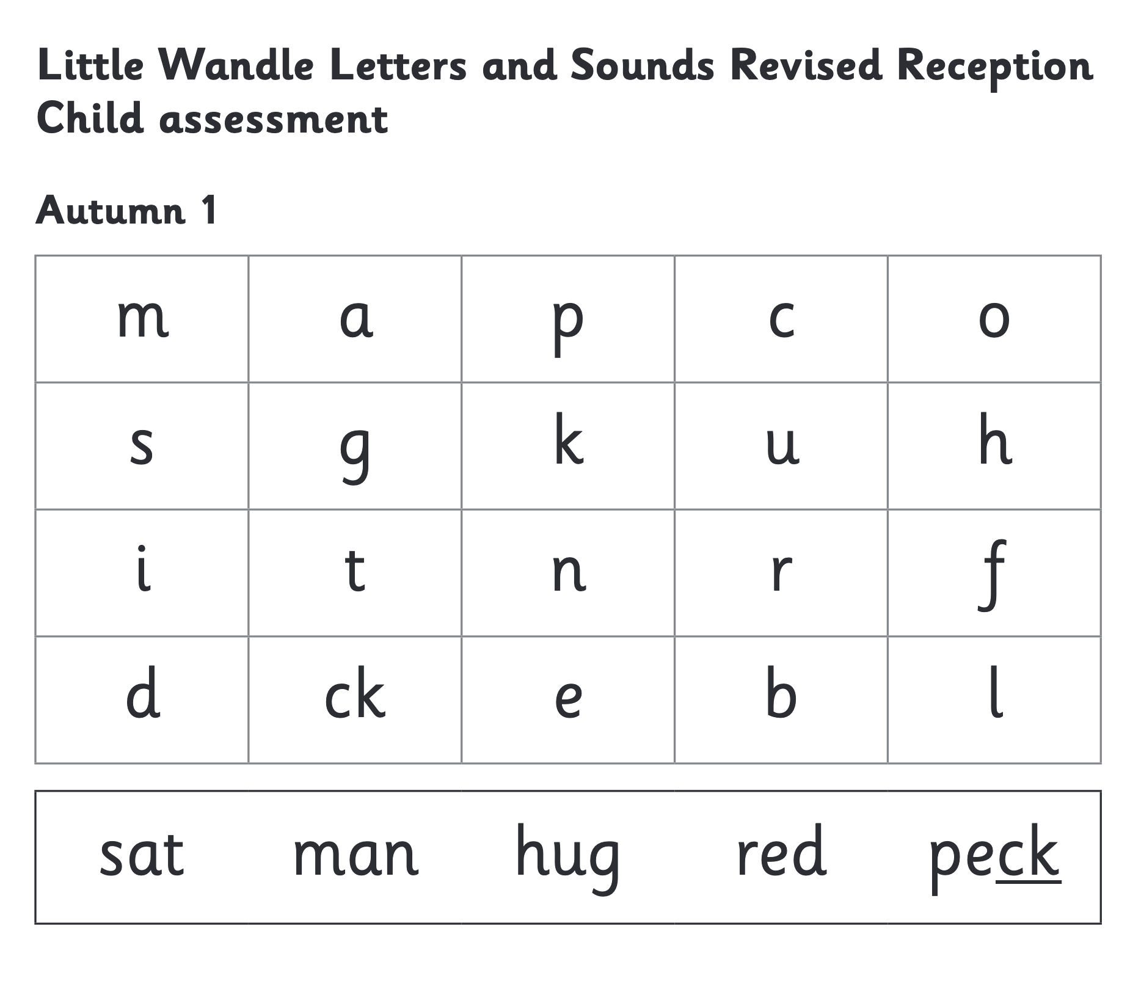
We use assessment to match your child the right level of book

Slide 21
Our reading pathway …
Once blending independently and secure – Little Wandle phonics books go home
Wordless stories - to build comprehension skills
Simple captions book – to model how to read simple caption, teacher voice.
Model: ‘Sound talk and blend’
Read and blend words
Reread the caption altogether without segmenting (use our ‘teacher voice’)

Slide 22
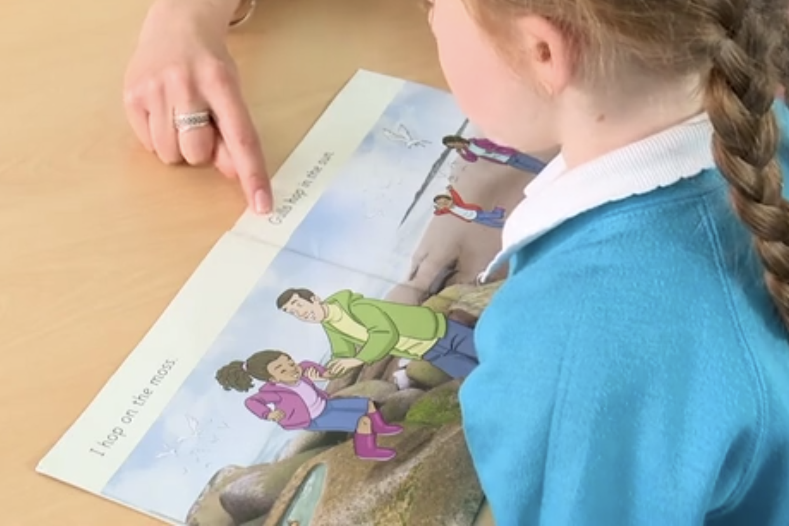
Reading a book at the right level
This means that your child should:
Know all the sounds and tricky words in their phonics book well
Read many of the words by silent blending (in their head) – their reading will be automatic
Only need to stop and sound out about 5% of the words by the time they bring the book home – but they should be able to do this on their own.

Slide 23


Books going home

Slide 24
• Additional
ORT phonics books are available to support. These can be sent home to support gaps in ‘letters’ and this allows the chn to practise blending these letters in words. gaps and blending
• Once the children are reading more confidently and fluently, reading phase 2 set 5 books confidently/ Phase 3 set 1, the chn will also take another book home from our ORT stages. This is to develop their comprehension, expression and fluency in reading.

Slide 25
Listening to your child read their phonics book
Your child should be able to read their book with minimal help.
If they can’t read a word read encourage them to use their phonics to blend the sounds. If they still struggle, read it to them.
Talk about the book and celebrate their success.

Slide 26

Read to your child
The shared book is for YOU to read:
Make the story sound as exciting as you can by changing your voice.
Talk with your child as much as you can:
  Introduce new and exciting language
  Encourage your child to use new vocabulary
  Make up sentences together
  Find different words to use
  Describe things you see.

Slide 27
One of the greatest gifts adults can give is to read to children
Carl Sagan

Slide 28
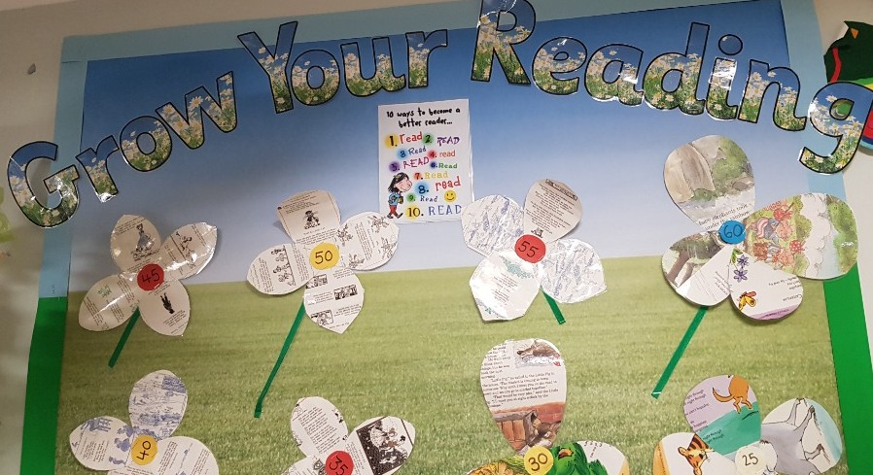

Slide 29
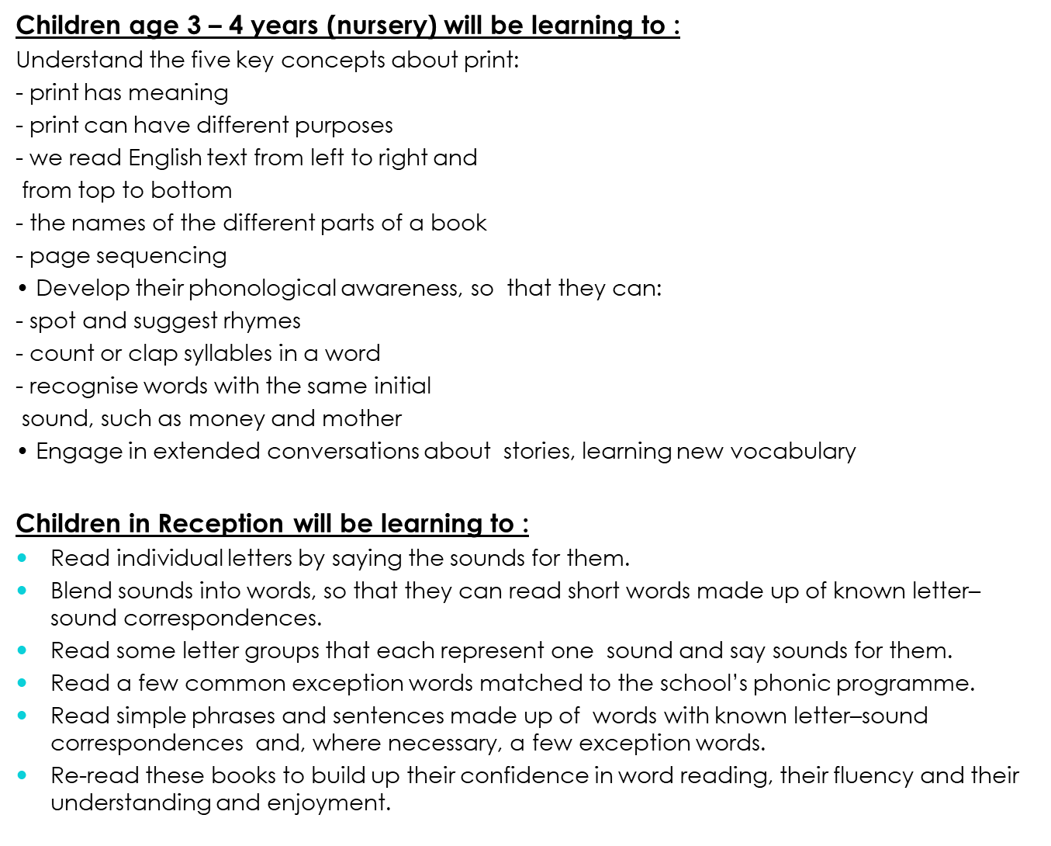

Slide 30
By the end of YR children should be able to :
Literacy
ELG: Comprehension
Children at the expected level of development will:
- Demonstrate understanding of what has been read to them by retelling stories
and narratives using their own words and recently introduced vocabulary;
- Anticipate – where appropriate – key events in stories;
- Use and understand recently introduced vocabulary during discussions about
stories, non-fiction, rhymes and poems and during role-play.
ELG: Word Reading
Children at the expected level of development will:
- Say a sound for each letter in the alphabet and at least 10 digraphs;
- Read words consistent with their phonic knowledge by sound-blending;
- Read aloud simple sentences and books that are consistent with their phonic
knowledge, including some common exception words.

Slide 31
